Slide 1


Slide 2
Agenda
Introduction
Problem statement
Objectives
Features
Technology stack
System architecture
Modules

Slide 3
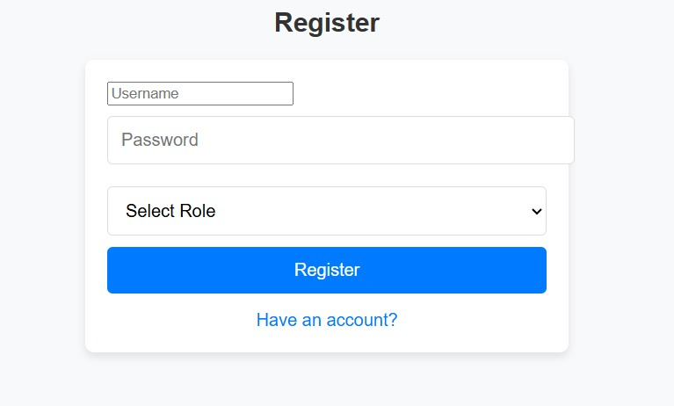
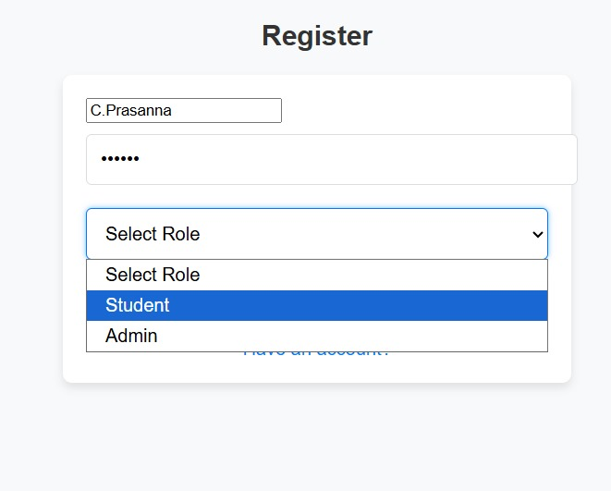

Slide 4
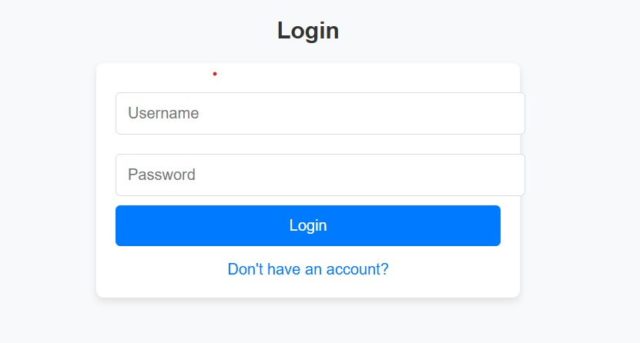
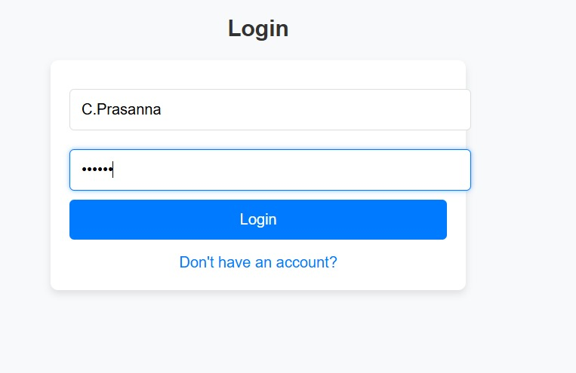

Slide 5


Slide 6


Slide 7
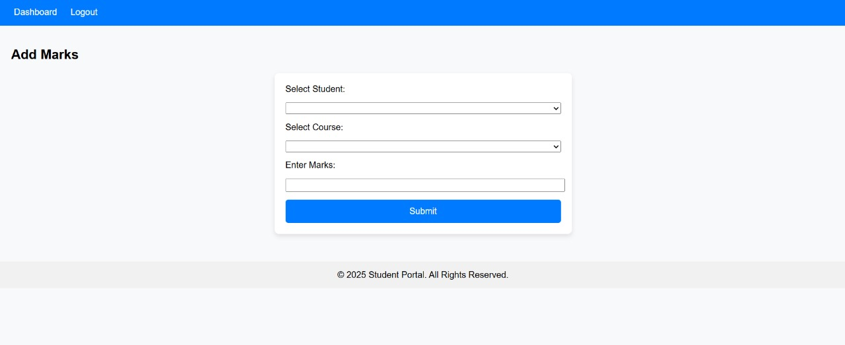

Slide 8
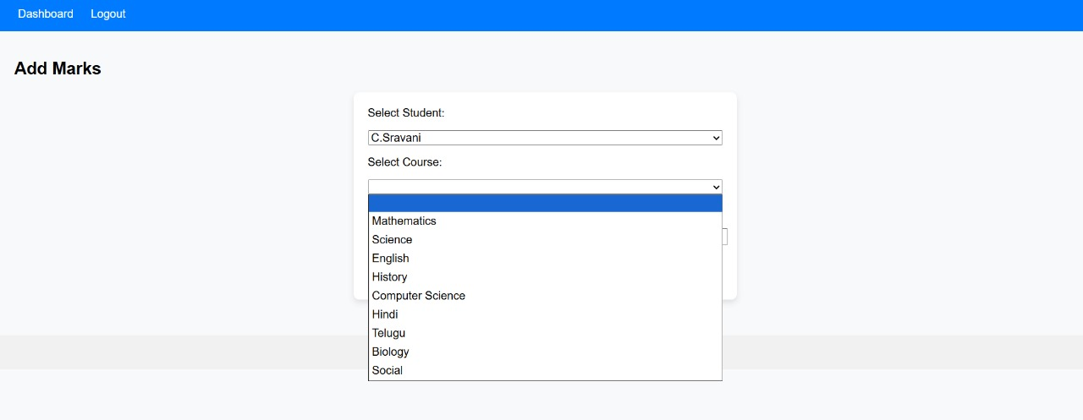

Slide 9


Slide 10
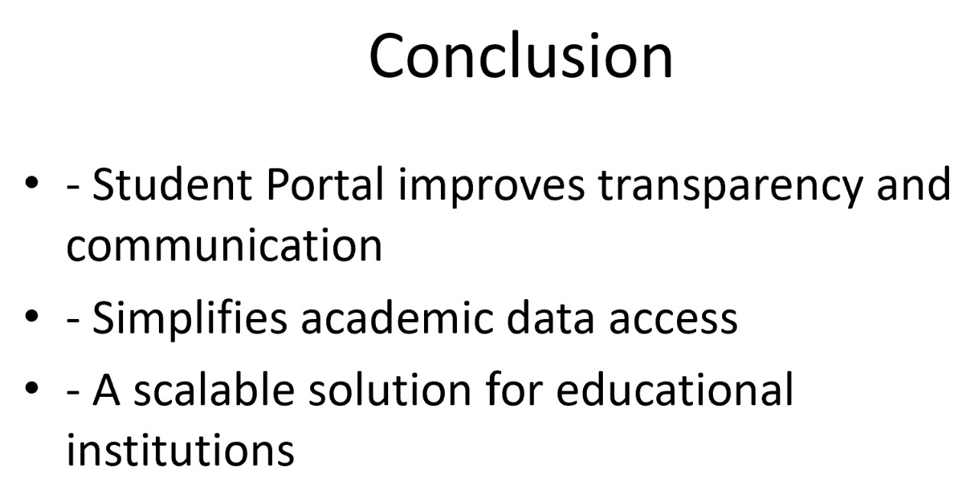

Slide 11


